Slide 1
10417/10617 Intermediate Deep Learning: Fall2020
Russ Salakhutdinov
Machine Learning Department
rsalakhu@cs.cmu.edu
Lectures 1,2

Slide 2
Evaluation
60% on 3 assignments, each worth 20%
40% on Final Project (10% mid-way report, 30% final report)

Slide 3
Evaluation
Tentative Assignment Dates-- check Piazza for updates:
Assignment 1: Out: Sep 16 -- Due: Sep 30
Assignment 2: Out: Oct 9 -- Due: Oct 23
Assignment 3 Part 1: Out: Oct 30 -- Due: Nov 9
Part 2: Out: Nov 11 – Due Nov 23
Tentative Project Report Dates:
Midway 3-page project report: Due Oct 30
Final 8-page project report: Due Dec 4

Slide 4
Evaluation
5 grace days for all assignments.
No more than 3 grace days per assignment.
After 3 late days, you will get 0.
No grace days for project
Unused grace days from homework CANNOT be applied to the project.
Late project reports will not be accepted.

Slide 5
Project
The idea of the final project is to give you some experience trying to do a piece of original research in machine learning and coherently writing up your result.
What is expected: A simple but original idea that you describe clearly, relate to existing methods, implement and test on some real-world problem.
To do this you will need to write some code, run it on some data, make figures, read a few background papers, collect some references, and write an 8-page report describing your model, algorithm, and results.

Slide 6
Text Books
Ian Goodfellow, Yoshua Bengio, Aaron Courville (2016)
Deep Learning Book (available online)
Christopher M. Bishop (2006) Pattern Recognition and Machine Learning, Springer.
Kevin Murphy (2013)
Machine Learning: A Probabilistic Perspective
Trevor Hastie, Robert Tibshirani, Jerome Friedman (2009) The Elements of Statistical Learning (available online)
David MacKay (2003) Information Theory, Inference, and Learning Algorithms
Most of the figures and material will come from these books.

Slide 7
Online Resources
We will be using a number of online resources, including
Joan Bruna’s Deep Learning Course
http://joanbruna.github.io/stat212b/
Hugo Larochelle Neural Network Course
http://info.usherbrooke.ca/hlarochelle/neural_networks/description.html
Deep Learning Summer School in Montreal
https://sites.google.com/site/deeplearningsummerschool2016/home
I will be adding more resources, check the webpage.

Slide 8

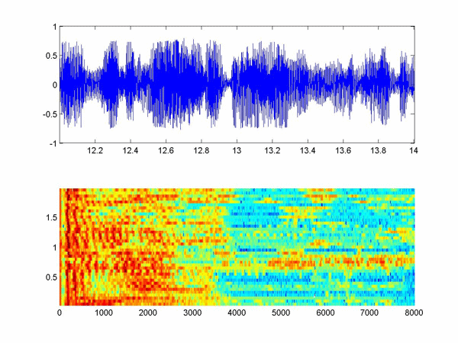

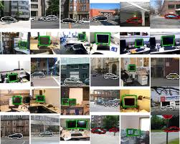




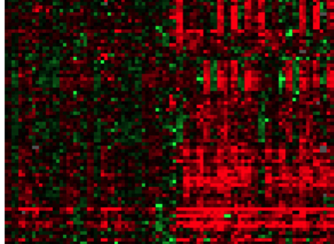

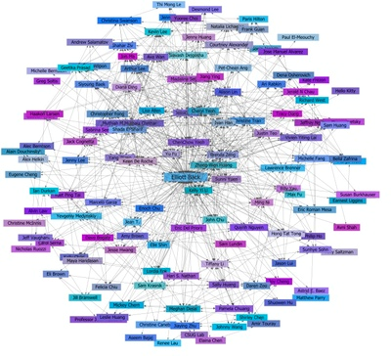

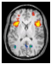
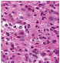



Mining for Structure
Massive increase in both computational power and the amount of data available from web, video cameras, laboratory measurements.
Images & Video
Text & Language
Speech & Audio
Gene Expression
Relational Data/
Social Network
Product
Recommendation
fMRI
Tumor region
Develop statistical models that can discover underlying structure, cause, or statistical correlation from data.
Multiple application domains.

Slide 9
Mining for Structure
Massive increase in both computational power and the amount of data available from web, video cameras, laboratory measurements.
Images & Video
Text & Language
Speech & Audio
Gene Expression
Deep Learning Models that support inferences and discover structure at multiple levels.
Relational Data/
Social Network
Product
Recommendation
fMRI
Tumor region
Develop statistical models that can discover underlying structure, cause, or statistical correlation from data.
Multiple application domains.

Slide 10





Impact of Deep Learning
Speech Recognition
Computer Vision
Recommender Systems
Language Understanding
Drug Discovery and Medical Image Analysis

Slide 11

Understanding Images:
TAGS:
strangers, coworkers, conventioneers, attendants, patrons
Nearest Neighbor Sentence:
people taking pictures of a crazy person
Model Samples
a group of people in a crowded area .
a group of people are walking and talking .
a group of people, standing around and talking .
a group of people that are in the outside .

Slide 12

Caption Generation

Slide 13

Caption Generation

Slide 14
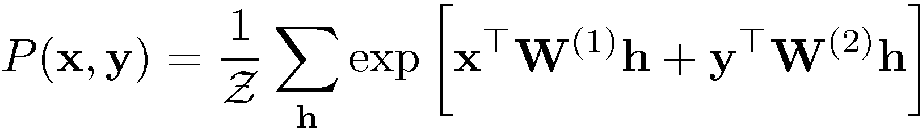
Example: Boltzmann Machine
Latent (hidden) variables
Model parameters
Input data (e.g. pixel intensities of an image, words from webpages, speech signal).
Target variables (response) (e.g. class labels, categories, phonemes).
Markov Random Fields, Undirected Graphical Models.

Slide 15
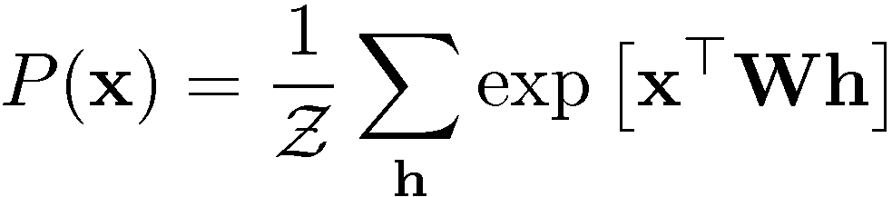

Finding Structure in Data
Vector of word counts on a webpage
Latent variables: hidden topics
804,414 newswire stories

Slide 16
Natural Language Understanding

Slide 17


Slide 18


Slide 19
Important Breakthroughs
Deep Belief Networks, 2006 (Unsupervised)
Hinton, G. E., Osindero, S. and Teh, Y., A fast learning algorithm for deep belief nets, Neural Computation, 2006.
Theoretical Breakthrough:
Adding additional layers improves variational lower-bound.
Higher-level
features:
Efficient Learning and Inference with multiple layers:
Low-level
features:
Edges
Efficient greedy layer-by-layer learning learning algorithm.
Inferring the states of the hidden variables in the top most layer is easy.
Input: Pixels

Slide 20
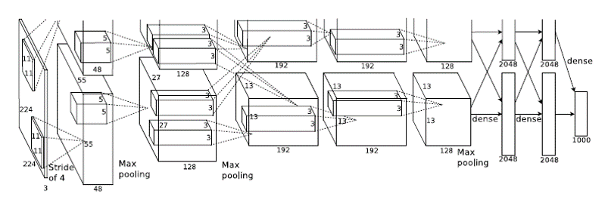
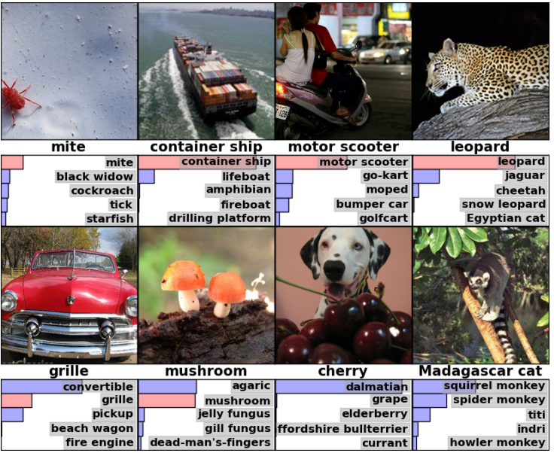
Important Breakthroughs
Deep Convolutional Nets for Vision (Supervised)
Krizhevsky, A., Sutskever, I. and Hinton, G. E., ImageNet Classification with Deep Convolutional Neural Networks, NIPS, 2012.
1.2 million training images
1000 classes
Deep Nets for Speech (Supervised)
Hinton et. al. Deep Neural Networks for Acoustic Modeling in Speech Recognition: The Shared Views of Four Research Groups, IEEE Signal Processing Magazine. 2012.

Slide 21
Statistical Generative Models
Training Data(CelebA)
Model Samples (Karras et.al., 2018)
4 years of progression on Faces
Brundage et al., 2017

Slide 22




Statistical Generative Models
Conditional generative model P(zebra images| horse images)
Style Transfer
Input Image
Monet
Van Gogh
Zhou el al., Cycle GAN 2017
Notes:
Much of the attention has been geared towards point estimation.

Slide 23
Statistical Generative Models
Conditional generative model P(zebra images| horse images)
Failure Case
Zhou el al., Cycle GAN 2017
Notes:
Much of the attention has been geared towards point estimation.

Slide 24
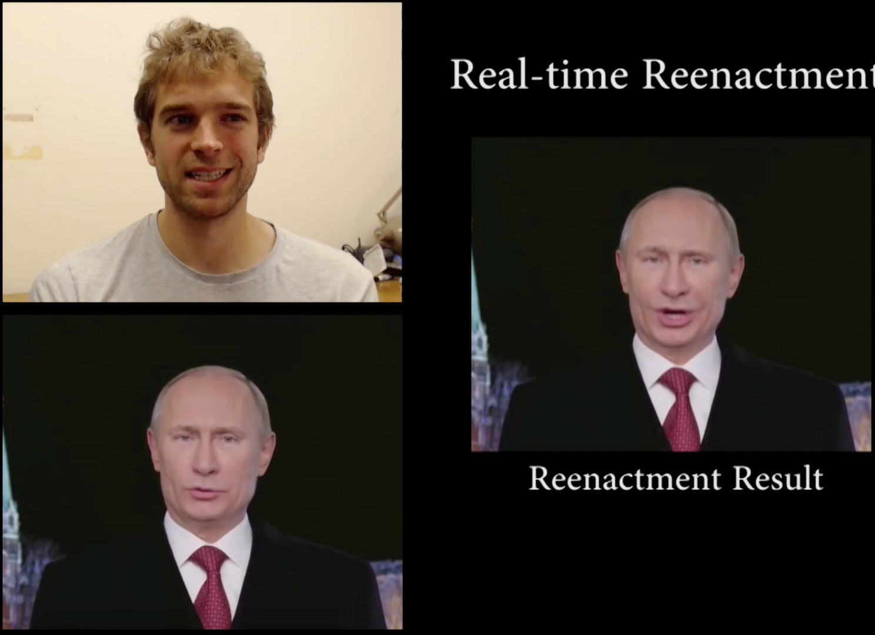
Statistical Generative Models
Source actor
Real-time reenactment
Target actor
[Face2Face, Thies et al, CVPR 2016]

Slide 25
Course Organization
Introduction / Background:
Linear Algebra, Distributions, Rules of probability.
Regression, Classification.
Feedforward neural nets, backpropagation algorithm.
Introduction to popular optimization and regularization techniques for deep nets.
Convolutional models with applications to computer vision.

Slide 26
Course Organization
Deep Learning Essentials:
Graphical Models: Directed and Undirected.
Autoencoders and its extensions.
Energy-based models, RBMs.
Deep Generative Models: Deep Belief Networks, Deep Boltzmann Machines, Helmholtz Machines,
Variational Autoencoders, Importance-weighted Autoencoders, Wake-Sleep Algorithm.
Generative Adversarial Networks (GANs), Generative Moment Matching Nets, Neural Autoregressive Density Estimator (NADE).

Slide 27
Course Organization
Additional Topics
More on Regularization and Optimization in Deep Nets.
Sequence Modeling: Recurrent Neural Networks.
Sequence-to-Sequence Architectures, Attention models.
Deep Reinforcement Learning.

Slide 28
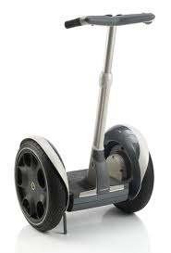
Learning Feature Representations
pixel 1
Learning Algorithm
pixel 2
Segway
Input Space
Non-Segway
pixel 1
pixel 2

Slide 29
Learning Feature Representations
Handle
Feature Representation
Learning Algorithm
Wheel
Segway
Input Space
Non-Segway
Feature Space
pixel 1
Wheel
pixel 2
Handle

Slide 30

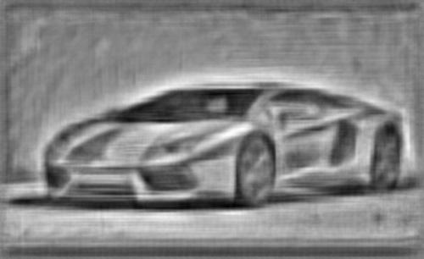
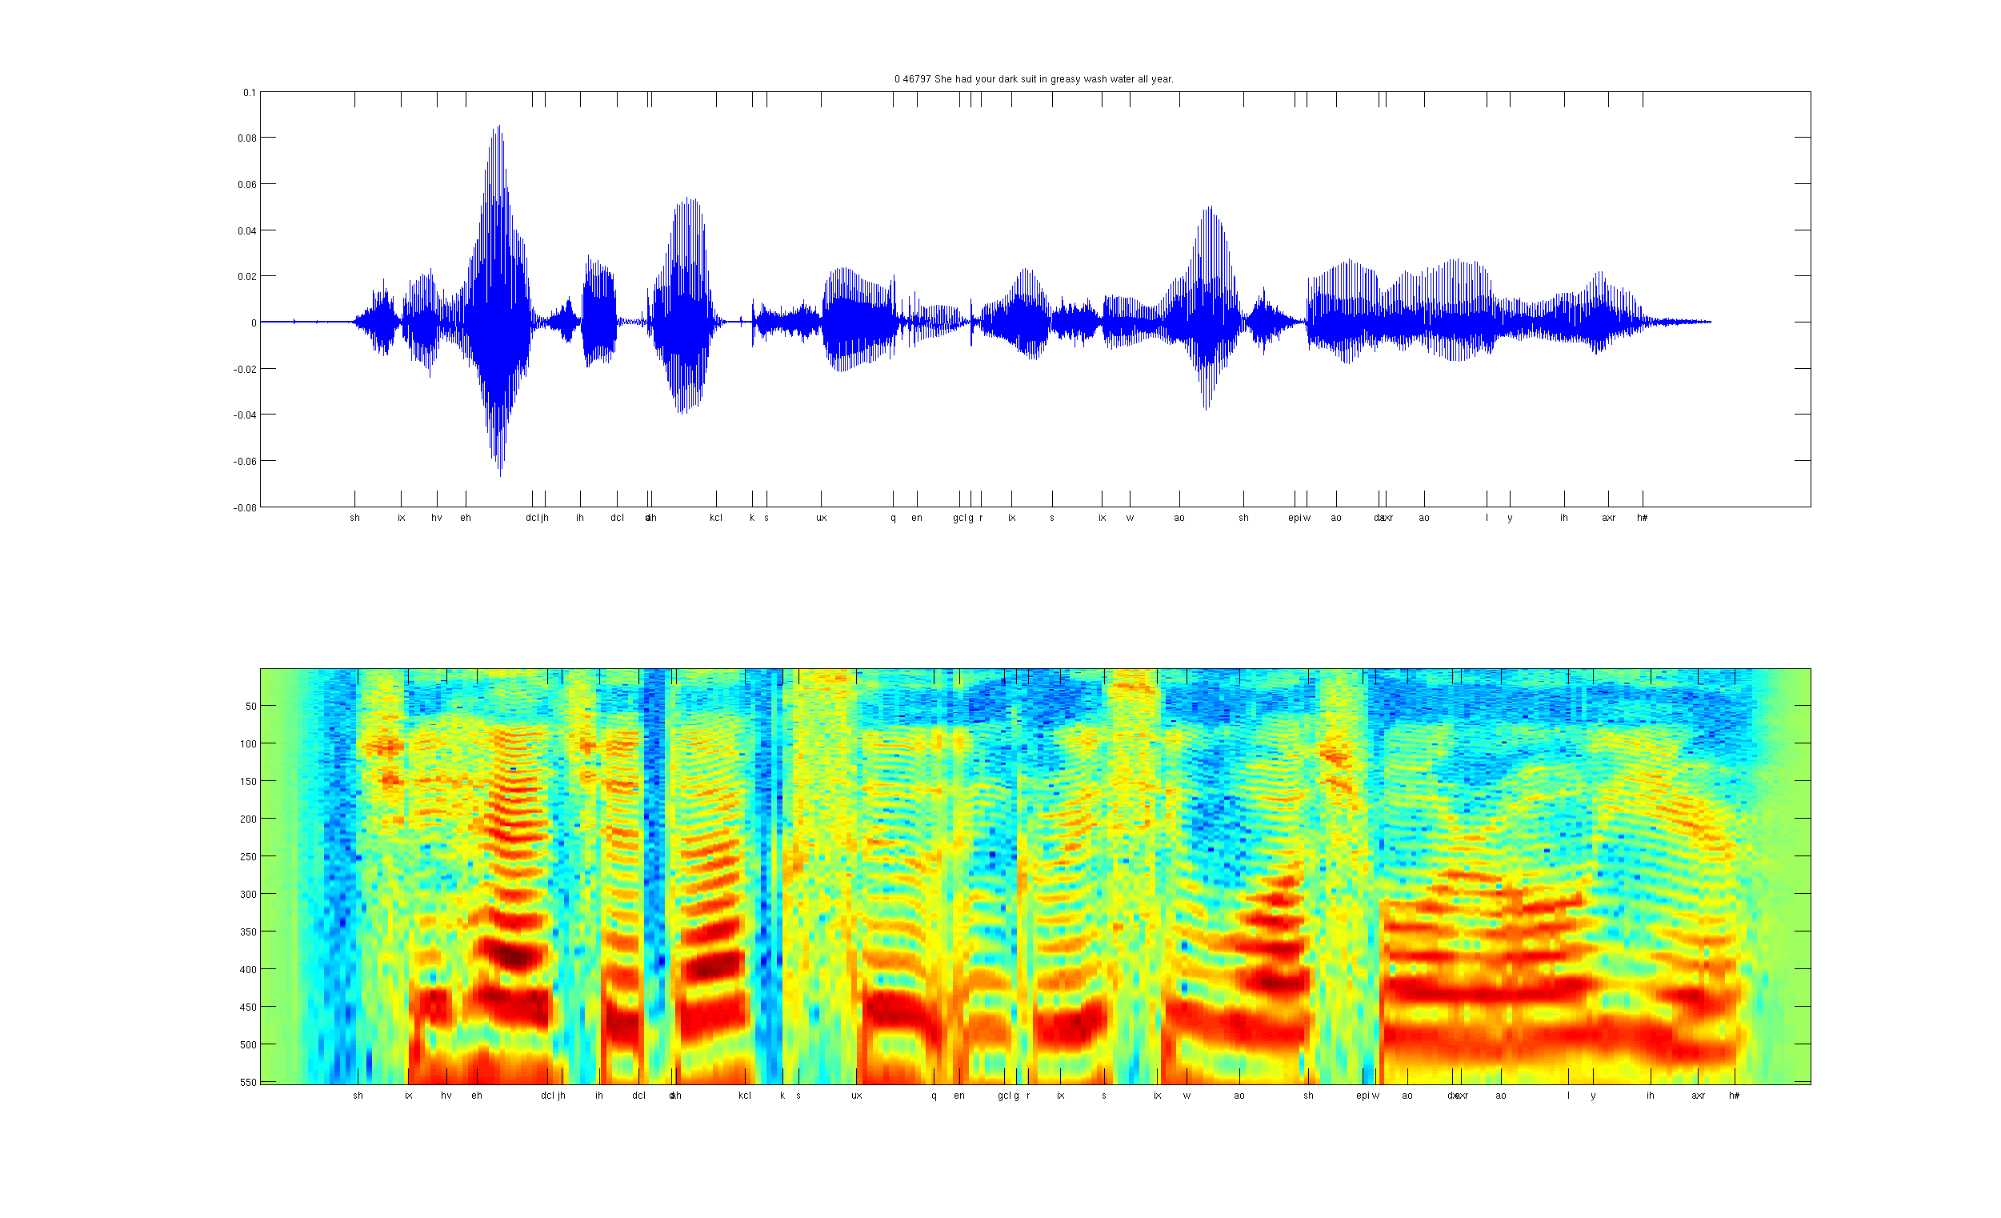

Traditional Approaches
Data
Feature extraction
Learning algorithm
Object detection
Image
vision features
Recognition
Audio classification
Audio
Speaker
identification
audio features

Slide 31
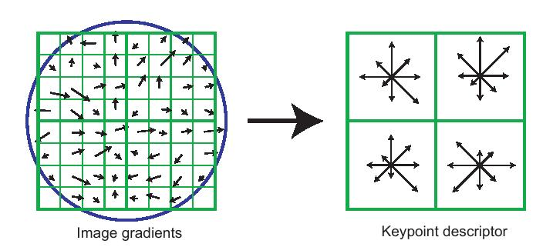
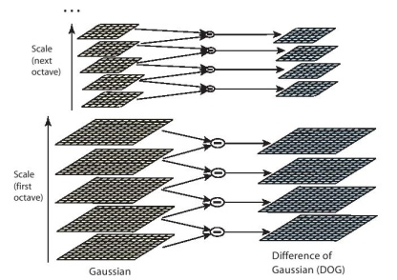
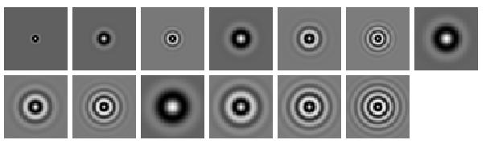
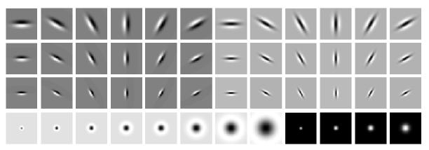
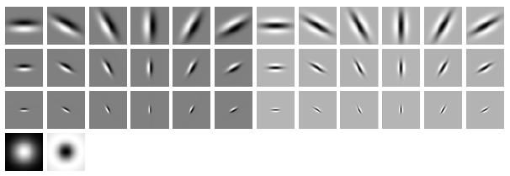
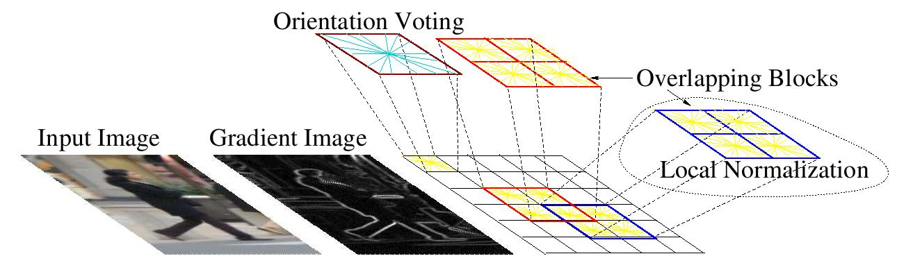
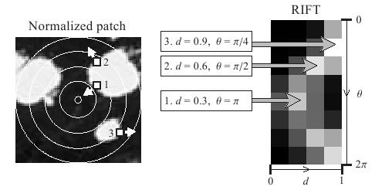
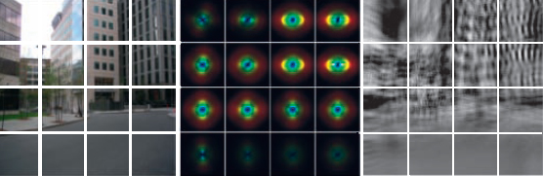
Computer Vision Features
SIFT
Textons
HoG
RIFT
GIST

Slide 32
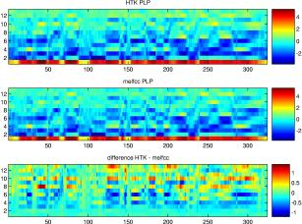
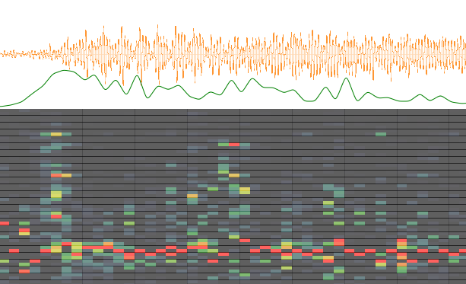
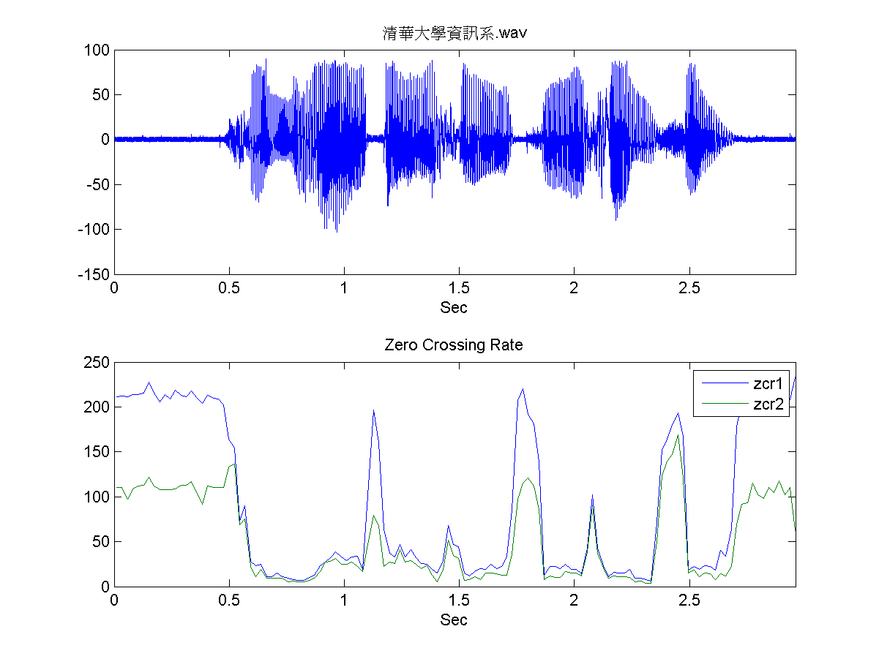
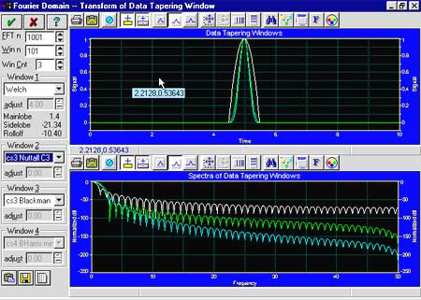
Audio Features
Spectrogram
MFCC
Flux
ZCR
Rolloff

Slide 33
Audio Features
Representation Learning:
Can we automatically learn these representations?
Spectrogram
MFCC
Flux
ZCR
Rolloff

Slide 34
Types of Learning
Consider observing a series of input vectors:
Supervised Learning: We are also given target outputs (labels, responses): y₁,y₂,…, and the goal is to predict correct output given a new input.
Unsupervised Learning: The goal is to build a statistical model of x, which can be used for making predictions, decisions.
Reinforcement Learning: the model (agent) produces a set of actions: a₁, a₂,… that affect the state of the world, and received rewards r₁, r₂… The goal is to learn actions that maximize the reward.
Semi-supervised Learning: We are given only a limited amount of labels, but lots of unlabeled data.

Slide 35
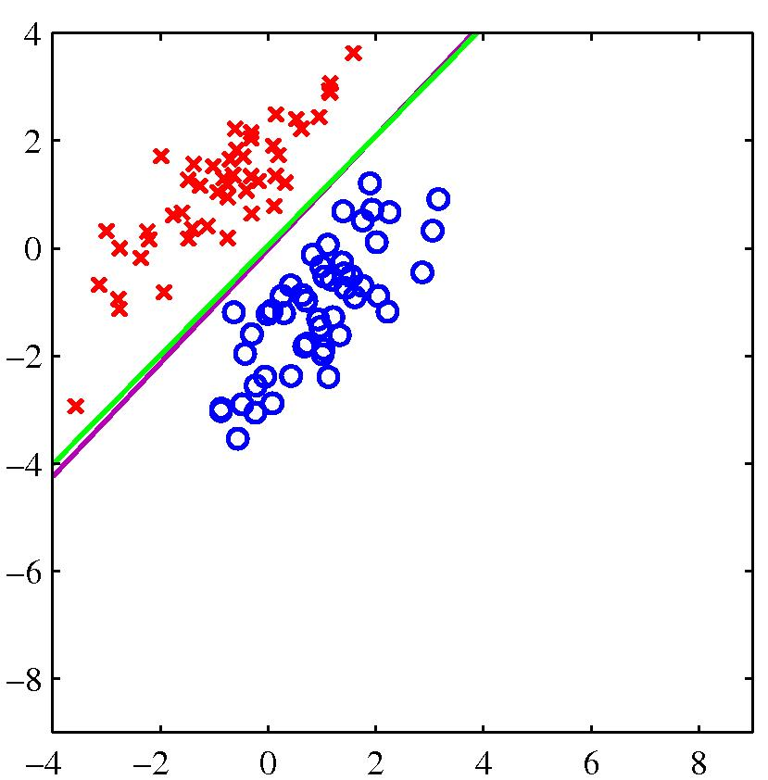
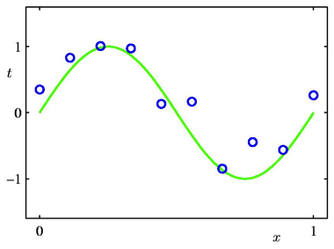
Supervised Learning
Classification: target outputs y_{i} are discrete class labels. The goal is to correctly classify new inputs.
Regression: target outputs y_{i} are continuous. The goal is to predict the output given new inputs.

Slide 36
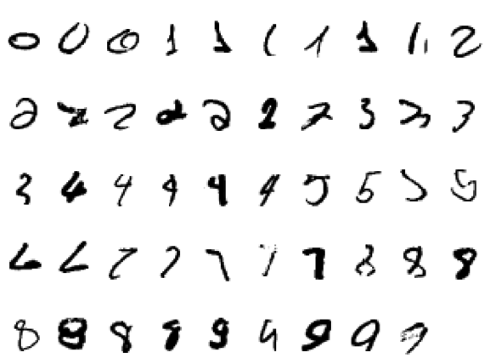
Handwritten Digit Classification

Slide 37
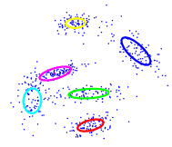
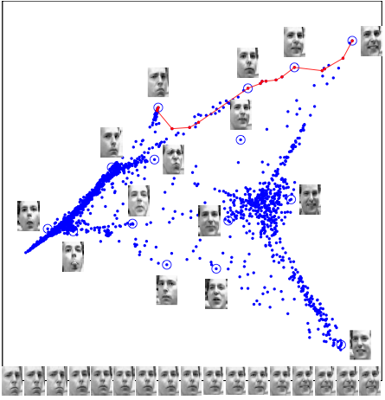
Unsupervised Learning
The goal is to construct statistical model that finds useful representation of data:
Clustering
Dimensionality reduction
Modeling the data density
Finding hidden causes (useful explanation) of the data
Unsupervised Learning can be used for:
Structure discovery
Anomaly detection / Outlier detection
Data compression, Data visualization
Used to aid classification/regression tasks

Slide 38
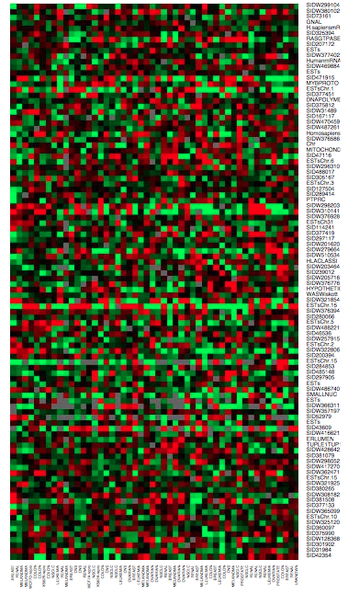
DNA Microarray Data
Expression matrix of 6830 genes (rows) and 64 samples (columns) for the human tumor data.
The display is a heat map ranging from bright green (under expressed) to bright red (over expressed).
Questions we may ask:
Which samples are similar to other samples in terms of their expression levels across genes.
Which genes are similar to each other in terms of their expression levels across samples.

Slide 39
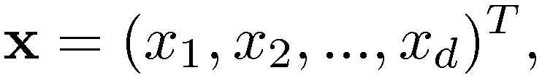
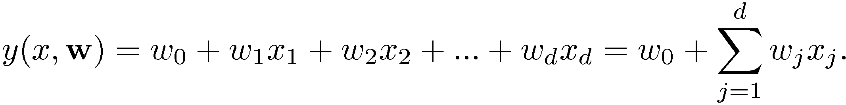
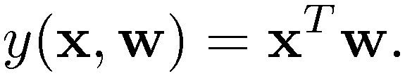
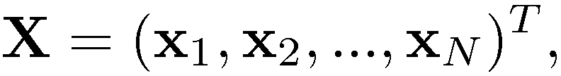
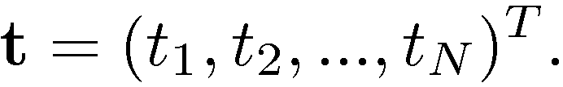
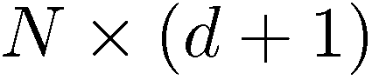
Linear Least Squares
Given a vector of d-dimensional inputs we want to predict the target (response) using the linear model:
The term w₀ is the intercept, or often called bias term. It will be convenient to include the constant variable 1 in x and write:
Observe a training set consisting of N observations together with the corresponding target values
Note that X is an matrix.

Slide 40
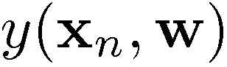
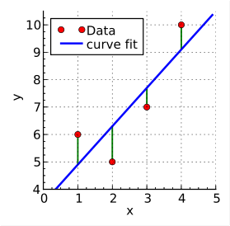
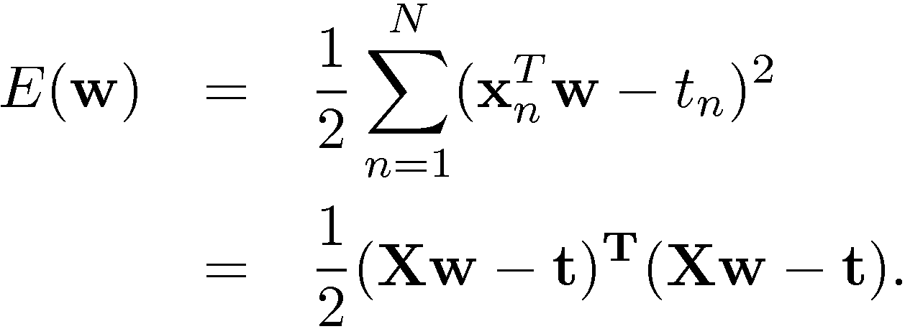
Linear Least Squares
One option is to minimize the sum of the squares of the errors between the predictions for each data point x_{n} and the corresponding real-valued targets t_{n}.
Loss function: sum-of-squared error function:
Source: Wikipedia

Slide 41
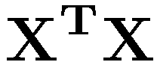
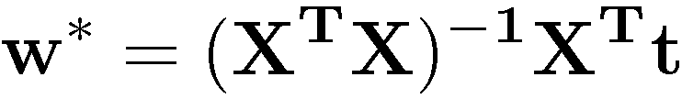
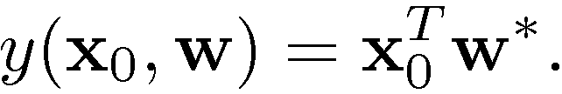
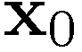
Linear Least Squares
If is nonsingular, then the unique solution is given by:
optimal weights
vector of target values
the design matrix has one input vector per row
Source: Wikipedia
At an arbitrary input , the prediction is
The entire model is characterized by d+1 parameters w*.

Slide 42
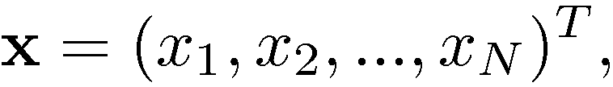
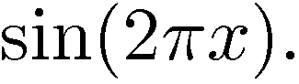
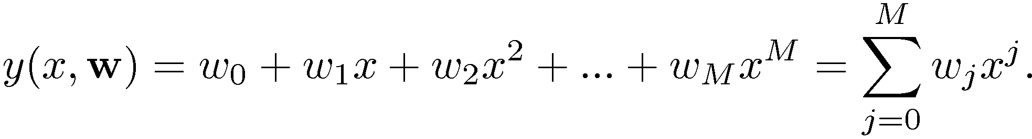
Example: Polynomial Curve Fitting
Consider observing a training set consisting of N 1-dimensional observations:
together with corresponding real-valued targets:
The green plot is the true function
The training data was generated by taking x_{n} spaced uniformly between [0 1].
The target set (blue circles) was obtained by first computing the corresponding values of the sin function, and then adding a small Gaussian noise.
Goal: Fit the data using a polynomial function of the form:
Note: the polynomial function is a nonlinear function of x, but it is a linear function of the coefficients w ! Linear Models.

Slide 43
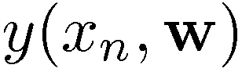
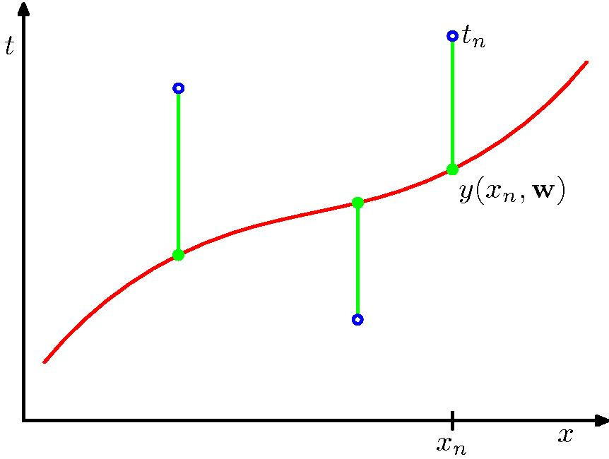

Example: Polynomial Curve Fitting
As for the least squares example: we can minimize the sum of the squares of the errors between the predictions for each data point x_{n} and the corresponding target values t_{n}.
Loss function: sum-of-squared error function:
Similar to the linear least squares: Minimizing sum-of-squared error function has a unique solution w*.
The model is characterized by M+1 parameters w*.
How do we choose M? ! Model Selection.

Slide 44




Some Fits to the Data
For M=9, we have fitted the training data perfectly.

Slide 45

Overfitting
Consider a separate test set containing 100 new data points generated using the same procedure that was used to generate the training data.
For M=9, the training error is zero ! The polynomial contains 10 degrees of freedom corresponding to 10 parameters w, and so can be fitted exactly to the 10 data points.
However, the test error has become very large. Why?

Slide 46

Overfitting
As M increases, the magnitude of coefficients gets larger.
For M=9, the coefficients have become finely tuned to the data.
Between data points, the function exhibits large oscillations.
More flexible polynomials with larger M tune to the random noise on the target values.

Slide 47


Varying the Size of the Data
9th order polynomial
For a given model complexity, the overfitting problem becomes less severe as the size of the dataset increases.
However, the number of parameters is not necessarily the most appropriate measure of the model complexity.

Slide 48
Generalization
The goal is achieve good generalization by making accurate predictions for new test data that is not known during learning.
Choosing the values of parameters that minimize the loss function on the training data may not be the best option.
We would like to model the true regularities in the data and ignore the noise in the data:
It is hard to know which regularities are real and which are accidental due to the particular training examples we happen to pick.
Intuition: We expect the model to generalize if it explains the data well given the complexity of the model.
If the model has as many degrees of freedom as the data, it can fit the data perfectly. But this is not very informative.
Some theory on how to control model complexity to optimize generalization.

Slide 49


A Simple Way to Penalize Complexity
One technique for controlling over-fitting phenomenon is regularization, which amounts to adding a penalty term to the error function.
penalized error
function
target value
regularization
parameter
where and ¸ is called the regularization term. Note that we do not penalize the bias term w₀.
The idea is to “shrink” estimated parameters towards zero (or towards the mean of some other weights).
Shrinking to zero: penalize coefficients based on their size.
For a penalty function which is the sum of the squares of the parameters, this is known as “weight decay”, or “ridge regression”.

Slide 50


Regularization
Graph of the root-mean-squared training and test errors vs. ln¸ for the M=9 polynomial.
How to choose ¸?

Slide 51

Cross Validation
If the data is plentiful, we can divide the dataset into three subsets:
Training Data: used to fitting/learning the parameters of the model.
Validation Data: not used for learning but for selecting the model, or choosing the amount of regularization that works best.
Test Data: used to get performance of the final model.
For many applications, the supply of data for training and testing is limited.
To build good models, we may want to use as much training data as possible.
If the validation set is small, we get noisy estimate of the predictive performance.
S fold cross-validation
The data is partitioned into S groups.
Then S-1 of the groups are used for training the model, which is evaluated on the remaining group.
Repeat procedure for all S possible choices of the held-out group.
Performance from the S runs are averaged.

Slide 52


Probabilistic Perspective
So far we saw that polynomial curve fitting can be expressed in terms of error minimization. We now view it from probabilistic perspective.
Suppose that our model arose from a statistical model:
where ² is a random error having Gaussian distribution with zero mean, and is independent of x.
Thus we have:
where ¯ is a precision parameter, corresponding to the inverse variance.
I will use probability distribution and probability density interchangeably. It should be obvious from the context.

Slide 53

Sampling Assumption
Assume that the training examples are drawn independently from the set of all possible examples, or from the same underlying distribution
We also assume that the training examples are identically distributed ! i.i.d assumption.
Assume that the test samples are drawn in exactly the same way -- i.i.d from the same distribution as the training data.
These assumptions make it unlikely that some strong regularity in the training data will be absent in the test data.

Slide 54





Maximum Likelihood
If the data are assumed to be independently and identically distributed (i.i.d assumption), the likelihood function takes form:
It is often convenient to maximize the log of the likelihood function:
Maximizing log-likelihood with respect to w (under the assumption of a Gaussian noise) is equivalent to minimizing the sum-of-squared error function.
Determine by maximizing log-likelihood. Then maximizing w.r.t. ¯:

Slide 55

Predictive Distribution
Once we determined the parameters w and ¯, we can make prediction for new values of x:

Slide 56

Statistical Decision Theory
We now develop a small amount of theory that provides a framework for developing many of the models we consider.
Suppose we have a real-valued input vector x and a corresponding target (output) value t with joint probability distribution:
Our goal is predict target t given a new value for x:
for regression: t is a real-valued continuous target.
for classification: t a categorical variable representing class labels.
The joint probability distribution provides a complete summary of uncertainties associated with these random variables.
Determining from training data is known as the inference problem.

Slide 57


Example: Classification
Medical diagnosis: Based on the X-ray image, we would like determine whether the patient has cancer or not.
The input vector x is the set of pixel intensities, and the output variable t will represent the presence of cancer, class C₁, or absence of cancer, class C₂.
C₁: Cancer present
C₂: Cancer absent
x -- set of pixel intensities
Choose t to be binary: t=0 correspond to class C₁, and t=1 corresponds to C₂.
Inference Problem: Determine the joint distribution , or equivalently
. However, in the end, we must make a decision of whether to give treatment to the patient or not.

Slide 58

Example: Classification
Informally: Given a new X-ray image, our goal is to decide which of the two classes that image should be assigned to.
We could compute conditional probabilities of the two classes, given the input image:
posterior probability of C_{k} given observed data.
probability of observed data given C_{k}
prior probability for class C_{k}
Bayes’ Rule
If our goal to minimize the probability of assigning x to the wrong class, then we should choose the class having the highest posterior probability.

Slide 59



Expected Loss
Loss Function: overall measure of loss incurred by taking any of the available decisions.
Suppose that for x, the true class is C_{k}, but we assign x to class j
! incur loss of L_{kj} (k,j element of a loss matrix).
Consider medical diagnosis example: example of a loss matrix:
Decision
Truth
Expected Loss:
Goal is to choose decision regions as to minimize expected loss.

Slide 60



Regression
Let x 2 R^{d} denote a real-valued input vector, and t 2 R denote a real-valued random target (output) variable with joint the distribution
The decision step consists of finding an estimate y(x) of t for each input x.
To quantify what it means to do well or poorly on a task, we need to define a loss (error) function:
The average, or expected, loss is given by:
If we use squared loss, we obtain:

Slide 61



Squared Loss Function
If we use squared loss, we obtain:
Our goal is to choose y(x) so as to minimize the expected squared loss.
The optimal solution (if we assume a completely flexible function) is the conditional average:
The regression function y(x) that minimizes the expected squared loss is given by the mean of the conditional distribution

Slide 62


Squared Loss Function
If we use squared loss, we obtain:
Plugging into expected loss:
expected loss is minimized
when
intrinsic variability of the
target values.
Because it is independent noise, it represents an irreducible minimum value of expected loss.

Slide 63


Other Loss Function
Simple generalization of the squared loss, called the Minkowski loss:
The minimum of is given by:
the conditional mean for q=2,
the conditional median when q=1, and
the conditional mode for q ! 0.

Slide 64




Discriminative vs. Generative
Generative Approach:
Model the joint density:
or joint distribution:
Infer conditional density:
Discriminative Approach:
Model conditional density directly.

Slide 65








Linear Basis Function Models
Remember, the simplest linear model for regression:
where is is a d-dimensional input vector (covariates).
Key property: linear function of the parameters .
However, it is also a linear function of the input variables.
Instead consider:
where are known as basis functions.
Typically , so that w₀ acts as a bias (or intercept).
In the simplest case, we use linear bases functions:
Using nonlinear basis allows the functions to be nonlinear functions of the input space.

Slide 66




Linear Basis Function Models
Polynomial basis functions:
Gaussian basis functions:
Basis functions are global: small changes in x affect all basis functions.
Basis functions are local: small changes in x only affect nearby basis functions.
¹_{j} and s control location and scale (width).

Slide 67




Linear Basis Function Models
Sigmoidal basis functions
Basis functions are local: small changes in x only affect nearby basis functions.
¹_{j} and s control location and scale (slope).
Decision boundaries will be linear in the feature space but would correspond to nonlinear boundaries in the original input space x.
Classes that are linearly separable in the feature space need not be linearly separable in the original input space.

Slide 68


Linear Basis Function Models
Original input space
Corresponding feature space using two Gaussian basis functions
We define two Gaussian basis functions with centers shown by green the crosses, and with contours shown by the green circles.
Linear decision boundary (right) is obtained using logistic regression, and corresponds to nonlinear decision boundary in the input space (left, black curve).

Slide 69



Maximum Likelihood
As before, assume observations arise from a deterministic function with an additive Gaussian noise:
which we can write as:
Given observed inputs , and corresponding target values , , under i.i.d assumption, we can write down the likelihood function:
where

Slide 70



Maximum Likelihood
Taking the logarithm, we obtain:
sum-of-squares error function
Differentiating and setting to zero yields:

Slide 71




Maximum Likelihood
Differentiating and setting to zero yields:
Solving for w, we get:
The Moore-Penrose pseudo-inverse, .
where is known as the design matrix:

Slide 72

Sequential Learning
The training data examples are presented one at a time, and the model parameters are updated after each such presentation (online learning):
weights after seeing training case t+1
learning rate
vector of derivatives of the squared error w.r.t. the weights on the training case presented at time t.
For the case of sum-of-squares error function, we obtain:
Stochastic gradient descent: The training examples are picked at random (dominant technique when learning with very large datasets).
Care must be taken when choosing learning rate to ensure convergence.

Slide 73





Regularized Least Squares
Let us consider the following error function:
¸ is called the regularization coefficient.
Data term + Regularization term
Using sum-of-squares error function with a quadratic penalization term, we obtain:
Ridge regression
which is minimized by setting:
The solution adds a positive constant to the diagonal of This makes the problem nonsingular, even if is not of full rank (e.g. when the number of training examples is less than the number of basis functions).

Slide 74

Effect of Regularization
The overall error function is the sum of two parabolic bowls.
The combined minimum lies on the line between the minimum of the squared error and the origin.
The regularizer shrinks model parameters to zero.

Slide 75


Other Regularizers
Using a more general regularizer, we get:
Lasso
Quadratic

Slide 76


The Lasso
Penalize the absolute value of the weights:
For sufficiently large ¸, some of the coefficients will be driven to exactly zero, leading to a sparse model.
The above formulation is equivalent to:
unregularized sum-of-squares error
The two approaches are related using Lagrange multiplies.
The Lasso solution is a quadratic programming problem: can be solved efficiently.

Slide 77

Lasso vs. Quadratic Penalty
Lasso tends to generate sparser solutions compared to a quadratic regualrizer (sometimes called L₁ and L₂ regularizers).

Slide 78



Bias-Variance Decomposition
Introducing a regularization term can help us control overfitting. But how can we determine a suitable value of the regularization coefficient?
Let us examine the expected squared loss function. Remember:
for which the optimal prediction is given
by the conditional expectation:
intrinsic variability of the target values: The minimum achievable value of expected loss
If we model using a parametric function then from a Bayesian perspective, the uncertainly in our model is expressed through the posterior distribution over parameters w.
We first look at the frequentist perspective.

Slide 79


Bias-Variance Decomposition
From a frequentist perspective: we make a point estimate of w* based on the dataset D.
We next interpret the uncertainly of this estimate through the following thought experiment:
Suppose we had a large number of datasets, each of size N, where each dataset is drawn independently from
For each dataset D, we can obtain a prediction function
Different datasets will give different prediction functions.
The performance of a particular learning algorithm is then assessed by taking the average over the ensemble of these datasets.
Let us consider the expression:
Note that this quantity depends on a particular dataset D.

Slide 80




Bias-Variance Decomposition
Consider:
Adding and subtracting the term we obtain
Taking the expectation over the last term vanishes, so we get:

Slide 81

Bias-Variance Trade-off
Average predictions over all datasets differ from the optimal regression function.
Solutions for individual datasets vary around their averages -- how sensitive is the function to the particular choice of the dataset.
Intrinsic variability of the target values.
Trade-off between bias and variance: With very flexible models (high complexity) we have low bias and high variance; With relatively rigid models (low complexity) we have high bias and low variance.
The model with the optimal predictive capabilities has to balance between bias and variance.

Slide 82










Bias-Variance Trade-off
Consider the sinusoidal dataset. We generate 100 datasets, each containing N=25 points, drawn independently from
High variance
Low variance
Low bias
High bias

Slide 83

Bias-Variance Trade-off
From these plots note that over-regularized model (large ¸) has high bias, and under-regularized model (low ¸) has high variance.

Slide 84
Beating the Bias-Variance Trade-off
We can reduce the variance by averaging over many models trained on different datasets:
In practice, we only have a single observed dataset. If we had many independent training sets, we would be better off combining them into one large training dataset. With more data, we have less variance.
Given a standard training set D of size N, we could generate new training sets, N, by sampling examples from D uniformly and with replacement.
This is called bagging and it works quite well in practice.
Given enough computation, we could also resort to the Bayesian framework:
Combine the predictions of many models using the posterior probability of each parameter vector as the combination weight.

